Slide 1

Mini Project-I (K24MCA18P) Odd Semester Session 2024-25
Skill Up Academy
Arun Kumar 2426MCA405
Anurag Singh Kushwaha 2426MCA1867
Deepanshu Ruhela 2426MCA2361
Project Supervisor:
MS. DIVYA SINGHAL
Assistant Professor

Slide 2
Content
Introduction (1 slide)
Literature Review (2 slides)
Objective of the Project (1 slide)
Technology
Hardware Requirements (Development Environment, Server requirement (if required), Client requirement (if required).
Software Requirements (Language and Platforms like Frameworks, VS code, Android Studio and Jupyter notebook etc. )
Modules (2-3 slides)
Workflow (1 slide)
Reports (For Example: Project : Student Monitoring System, so reports like: Student Marks, Subjects, companies visit, and student appears in placement etc.)
References (1 slide)
Notes:
Font Styles: Times New Roman + Font Size: 25

Slide 3
Introduction
Skill Up Academy
Skill Up Academy is an emerging online educational platform aimed at delivering high-quality, accessible, and inclusive education. The platform provides learners with the tools to upskill in various domains, promoting lifelong learning.
Notes:
Font Styles: Times New Roman + Font Size: 25

Slide 4


Slide 5
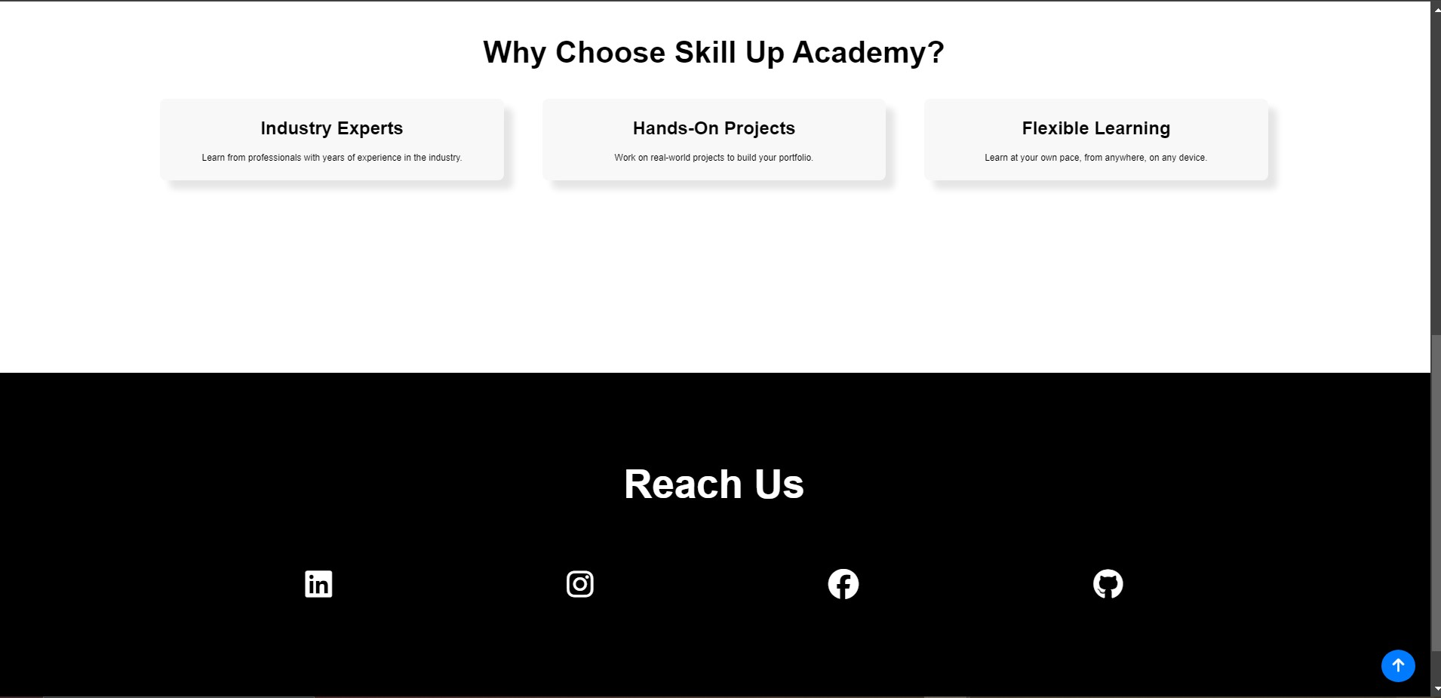

Slide 6
Literature Review
This review will contextualize skill Up Academy’s offerings within the broader research on e-learning, online education quality, and the effectiveness of digital platforms in enhancing educational outcomes for free.
Notes:
Font Styles: Times New Roman + Font Size: 25

Slide 7
Objective of the Project
Apply Knowledge in Real-World Scenarios
Critical Thinking and Problem Solving
Promote Lifelong Learning
Collaborate and Communicate Effectively
Learner have not to pay any course fee , we display some adds ,promotions and whatever the money will be collected ,we purchase some professional courses and give to our verified learner
Show score in the last
Notes:
Font Styles: Times New Roman + Font Size: 25

Slide 8
Technology (Hardware Requirements)
Desktop/Laptop
Operating System: Windows 10+, macOS 10.13+, Linux.
Processor: Intel i3 (min), Intel i5 (recommended).
RAM: 4GB (min), 8GB+ (recommended).
Storage: 10GB free space.
Graphics: Integrated or NVIDIA GeForce GTX 1050 (for design/multimedia)
Notes:
Font Styles: Times New Roman + Font Size: 25

Slide 9
Technology (Software Requirements)
Web Browser: Chrome, Firefox, Safari, Edge (latest versions).
PDF Viewer: Adobe Acrobat Reader or equivalent.
Text Editor/IDE (for coding): Visual Studio Code, Notebook.
Design/Multimedia: Adobe Creative Suite, Blender, Figma.
Notes:
Font Styles: Times New Roman + Font Size: 25

Slide 10
Modules
User Registration and Authentication Module
Form Fields
Email Verification
Password Strength Validation
User Login
Authentication
Remember Me Option
Contact Module
Email, Contact no.
Notes:
Font Styles: Times New Roman + Font Size: 25

Slide 11
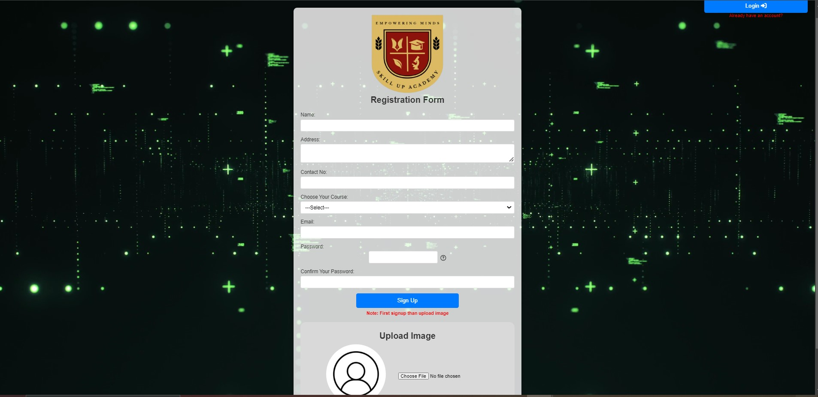

Slide 12
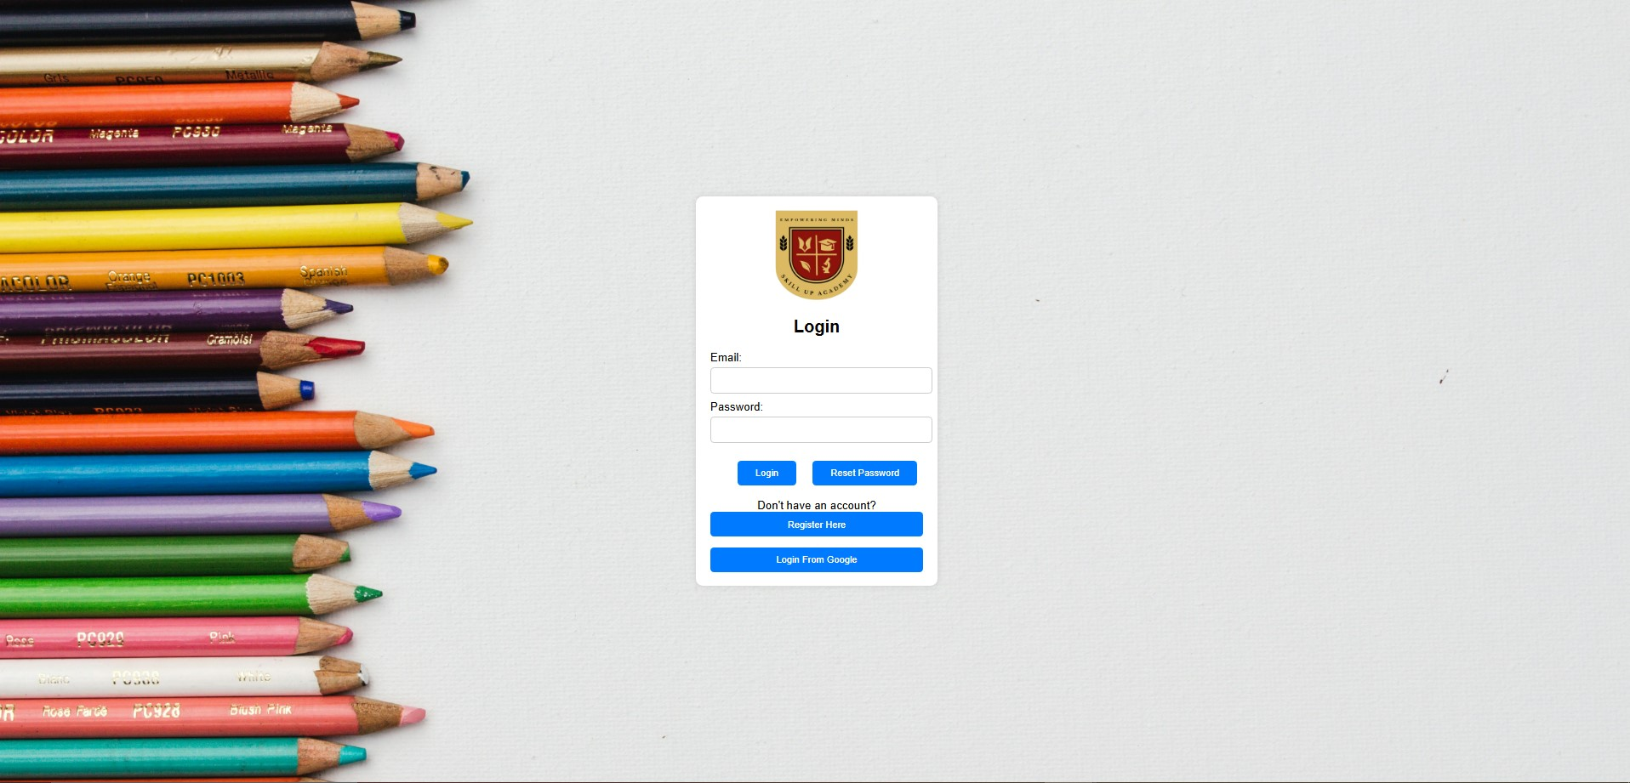

Slide 13
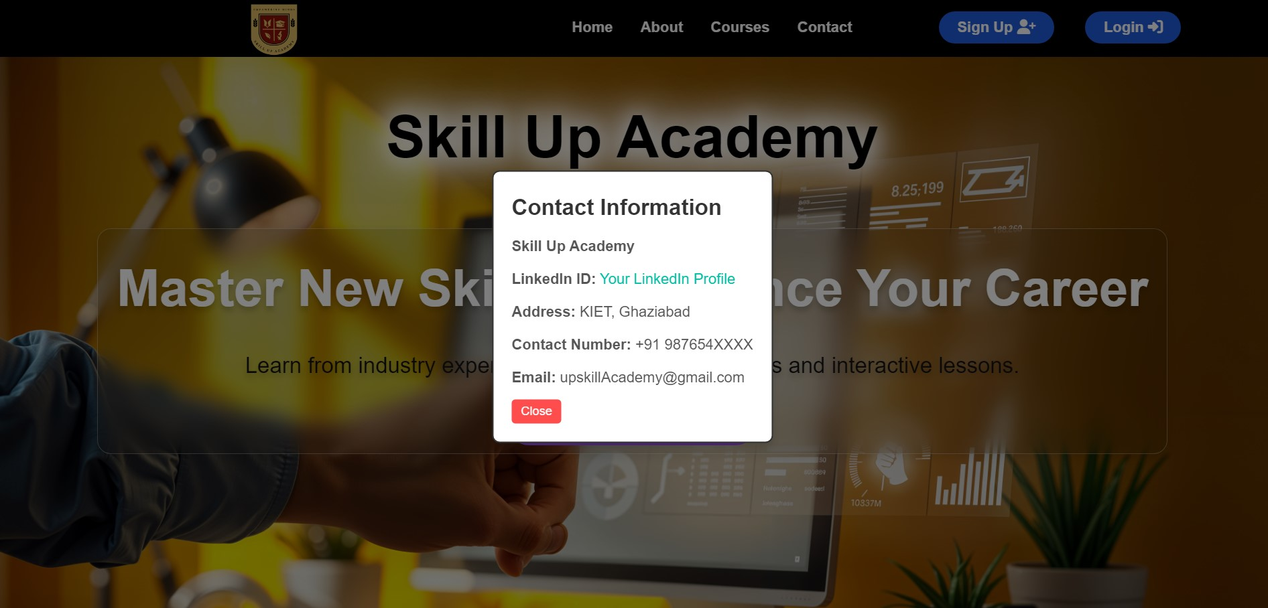

Slide 14
Modules (Contd.)
Courses Listing
Result Generation
Mentorship
It is used for to check the how many users are registered and use our course
Mentor is a special authorized person
Notes:
Font Styles: Times New Roman + Font Size: 25

Slide 15
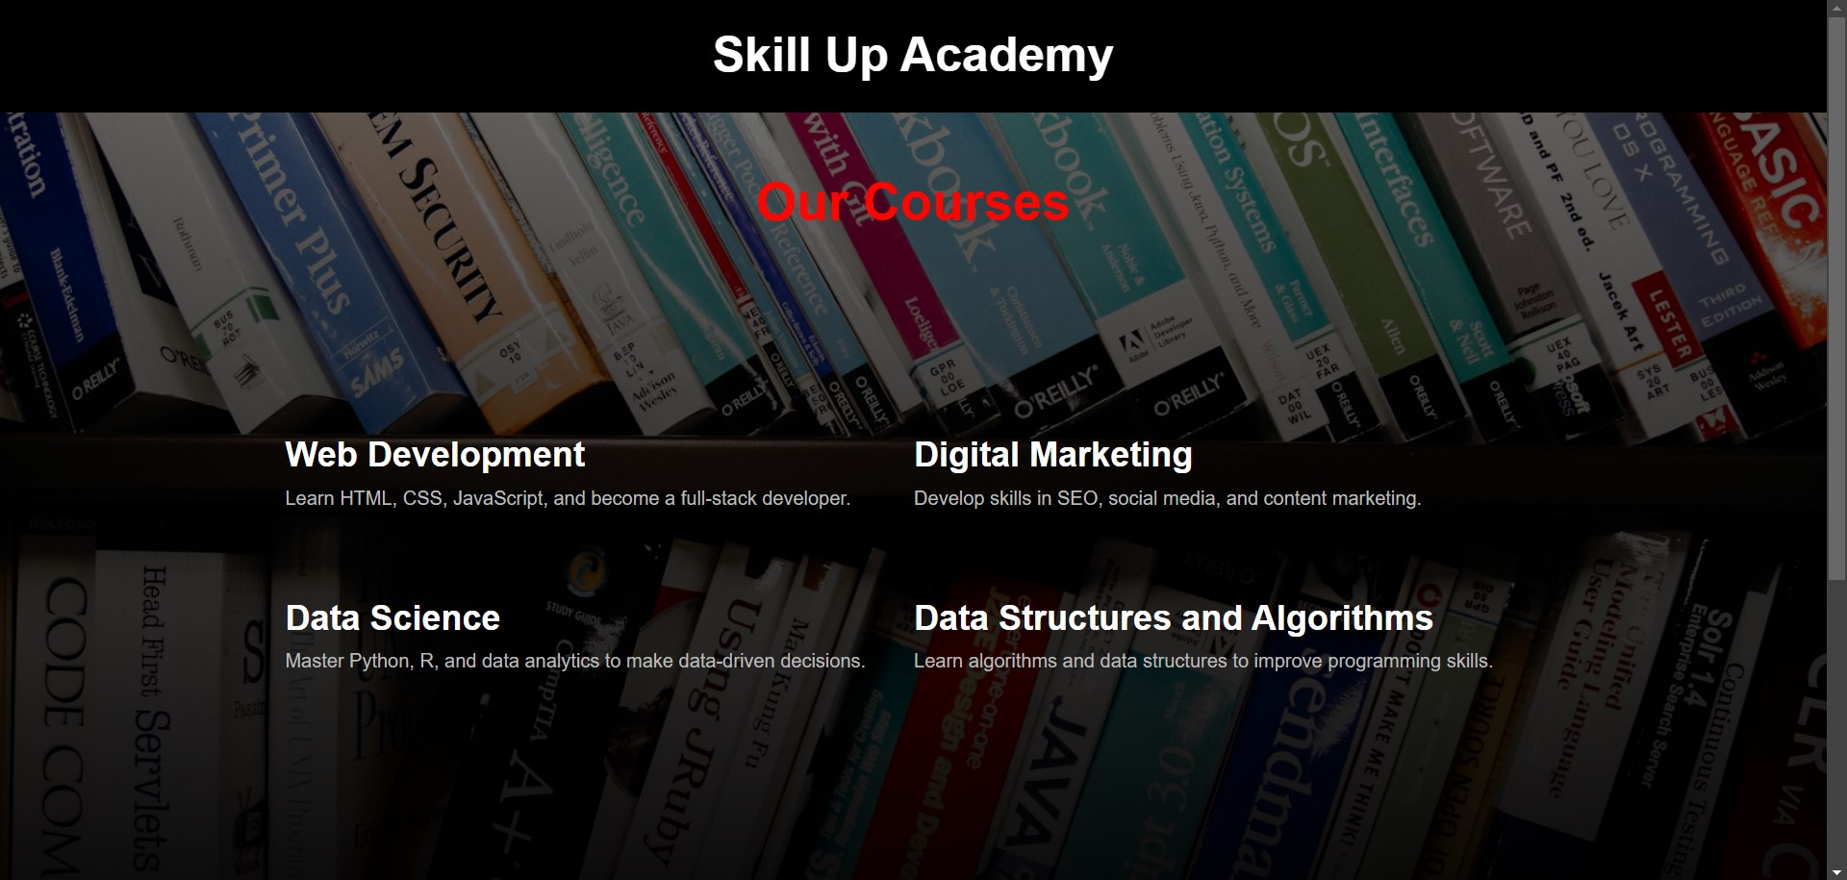

Slide 16
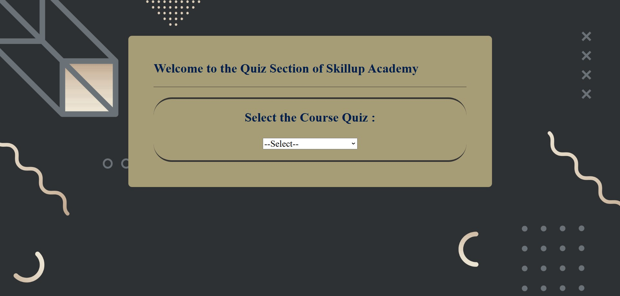

Slide 17
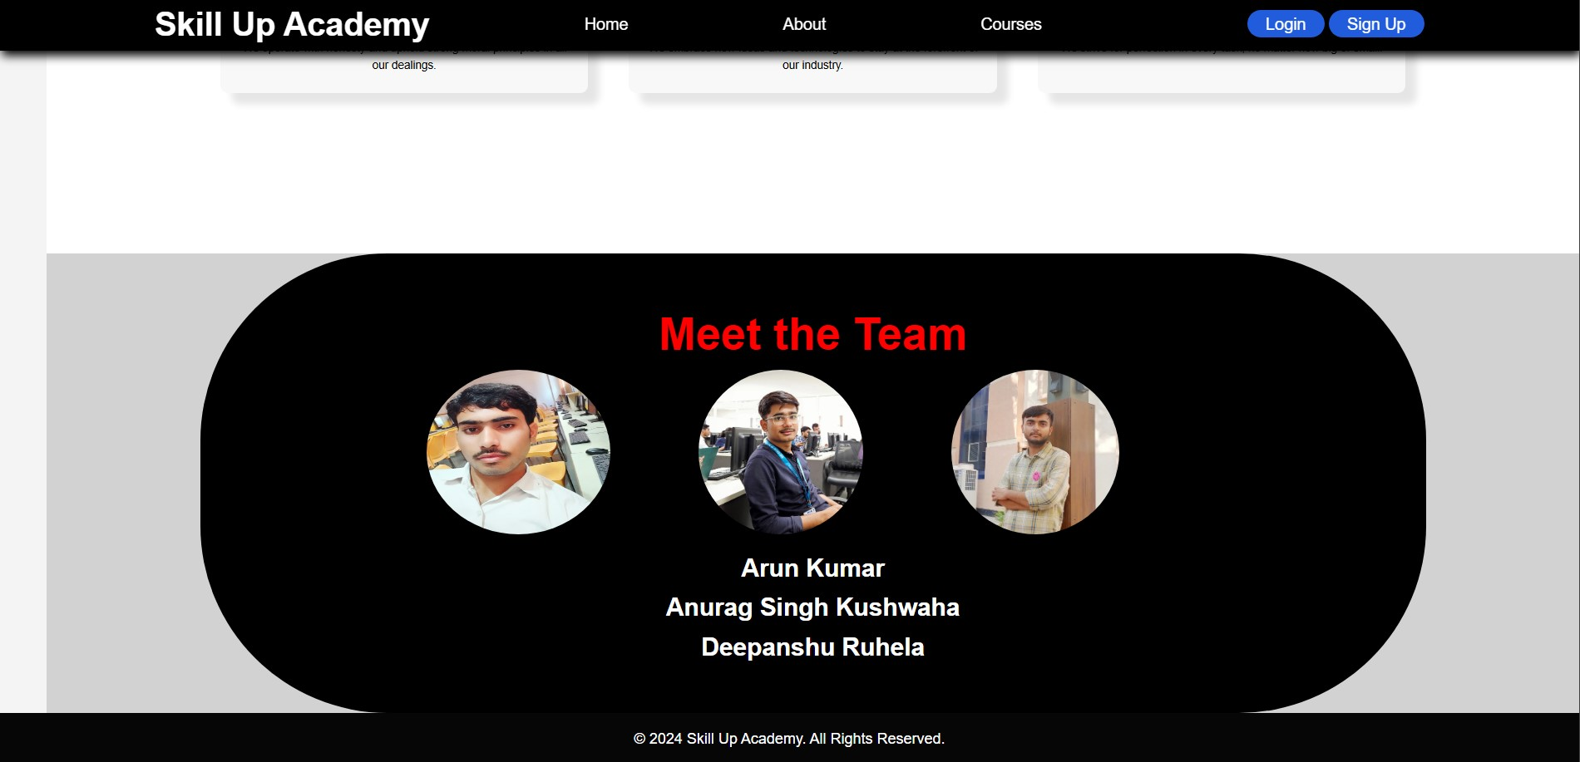

Slide 18
Workflow/Gantt Chart
User opens Skill Up Academy
Design and Prototyping
Frontend Development: HTML, CSS, and JavaScript implementation.
Testing and Quality Assurance
Maintenance and Updates
Notes:
Font Styles: Times New Roman + Font Size: 25

Slide 19
Reports
Expand course offerings and include multimedia content (videos, quizzes).
Integrate a backend system for user management and course data storage.
Enhance user engagement features, such as forums and discussion boards
Notes:
Font Styles: Times New Roman + Font Size: 25

Slide 20
References
Documentation for HTML, CSS, and JavaScript.
Tutorials and courses from reputable platforms (e.g., freeCodeCamp, W3Schools,youtube etc).
User experience design resources.
Notes:
Font Styles: Times New Roman + Font Size: 25

